Slide 1
FDSCI – Issues in Science
Issues in Science Course Options and Brief Descriptions

Slide 2
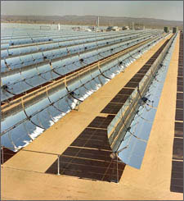
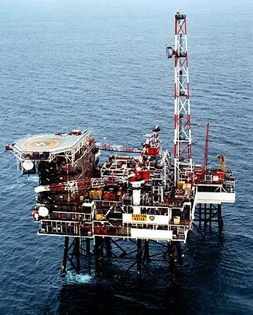
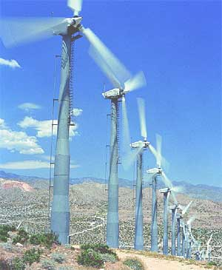
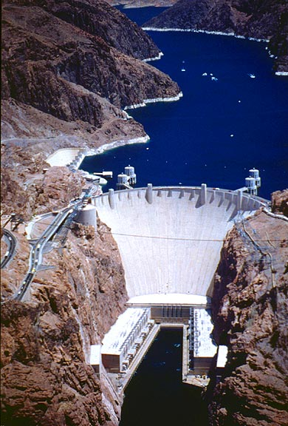
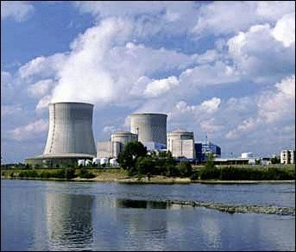
FDSCI 200 - Energy in the 21st Century
This course gives students opportunities to investigate and examine the costs, benefits, and options associated with the technical, environmental, social, and economic issues related to the development of energy resources.

Slide 3
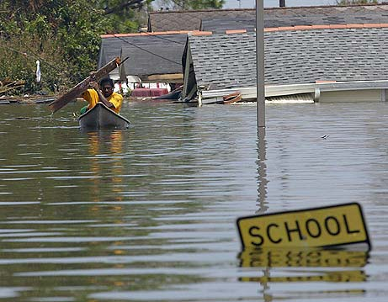
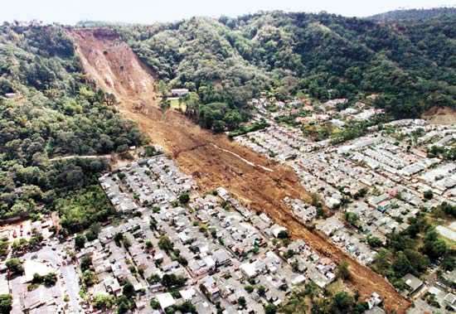
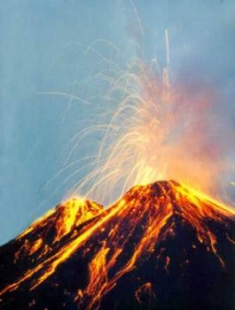
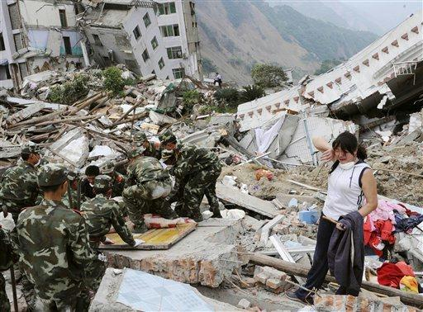
FDSCI 201 - Natural Disasters
This course gives students opportunities to examine causes and effects of earthquakes, volcanoes, landslides, floods, and coastal hazards. Students study ancient and modern disasters and their impacts on science, engineering, history, economics, politics, and the arts.

Slide 4
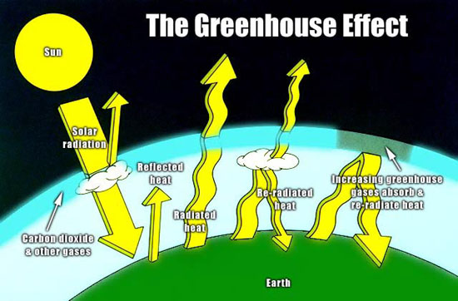
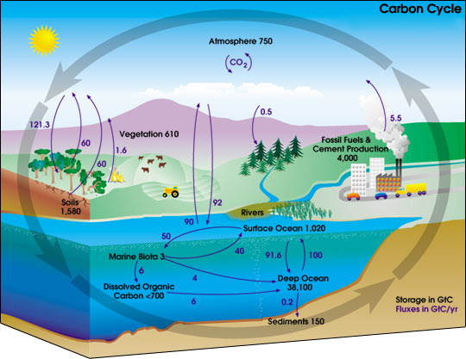
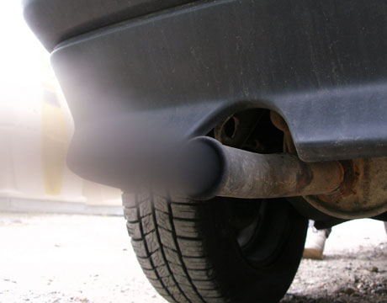
FDSCI 202 - Issues in Global Climate Change
In this class students explore the scientific consensus and skepticism of the theory of man-made global warming, including the arguments for and against the theory. This exploration includes learning the science behind atmospheric and oceanic processes and chemistry related to climate change, as well as their potential effects on future climate change. The class also includes discussion on the role of the media, government, corporations, etc., in the debate. The end goal is for the students to gain the skills necessary to evaluate whether claims from media sources are reliable or not.

Slide 5
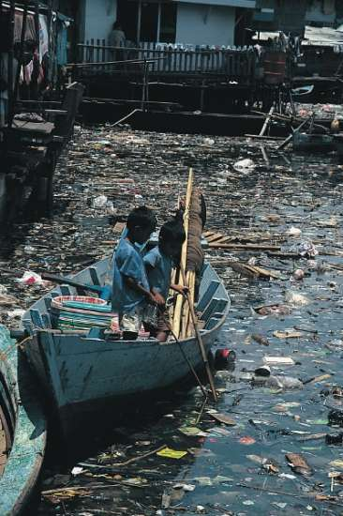
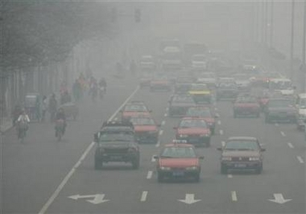

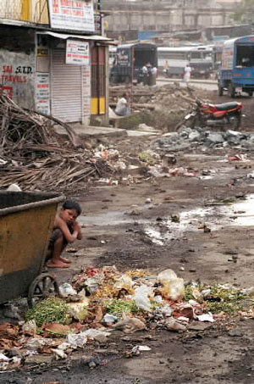
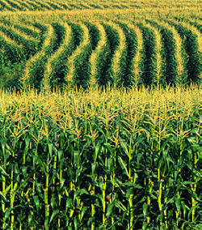
FDSCI 203 - Environmental Stewardship
In this course students examine the effects of humans on local, regional, and global scales by considering ecological, biological, agricultural, technological, socio-economic, political and other issues associated with human population trends. The goal of this course is to help students learn to make informed choices about their lives, families, and communities and be better stewards of the Earth’s resources.

Slide 6
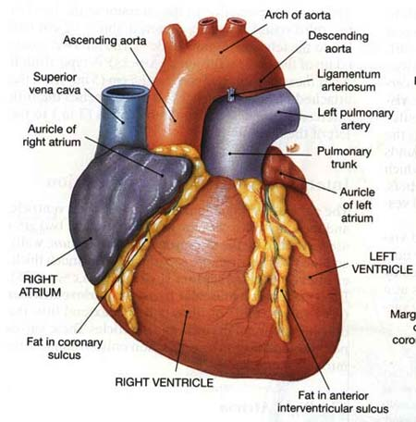


FDSCI 204 - The American Epidemic
Cardiovascular disease and diabetes are diseases that are highly correlated with lifestyle choices, and are leading causes of death and morbidity in the U.S. Students in this course study the physiological mechanisms and costs of these diseases. Students also develop and implement personal programs to facilitate life-long health and wellness.

Slide 7
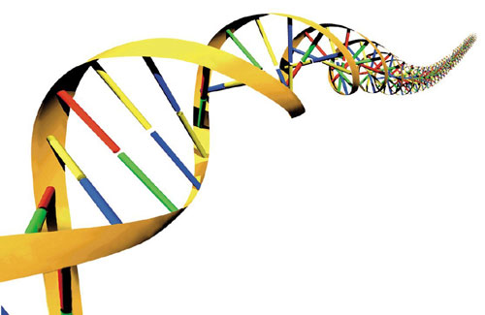
FDSCI 205 - DNA: Identity, Disease, Design
Students in this course study fundamental concepts related to DNA: structure and function, regulation, inheritance, genetic disorders and connections to cancer, the creation of genetically modified foods, DNA fingerprinting, and cloning and stem cell technology. We also consider the role DNA plays in the underlying mechanism of organic evolution, and other impacts of DNA and DNA technologies on human communities.

Slide 8

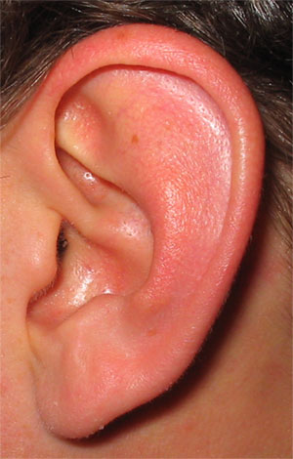
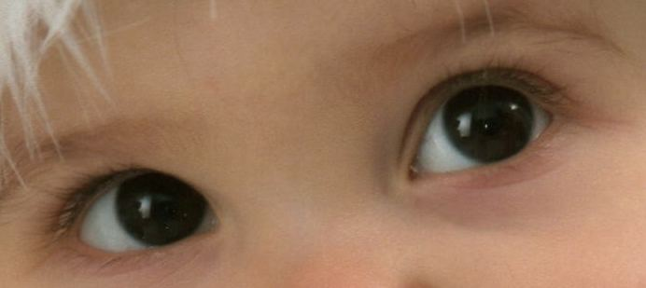
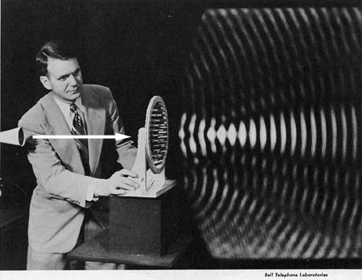
FDSCI 206 - Light & Sound
Students in this course learn about the physical characteristics of light and sound, the biological nature of eyes and ears, and the sensations of vision and hearing as integrated and interpreted by the brain. Students also evaluate the influence of music, movies, advertising, and video games on the human mind and behavior.

Slide 9
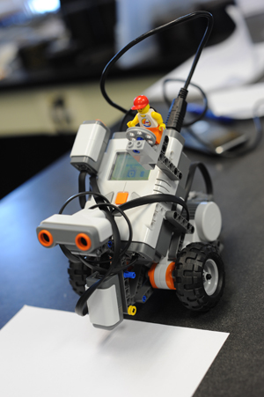
FDSCI 208 - Introduction to Robotics
Is there a robot in your future?
Hybrid course—online lecture and weekly two-hour lab
Work in groups using Lego Mindstorm robot kits to win design competitions

Slide 10
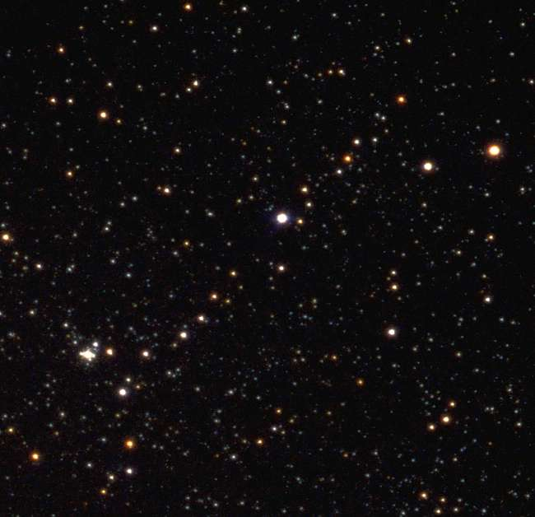
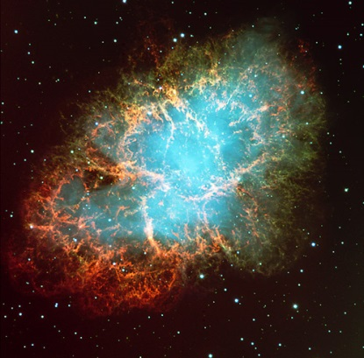
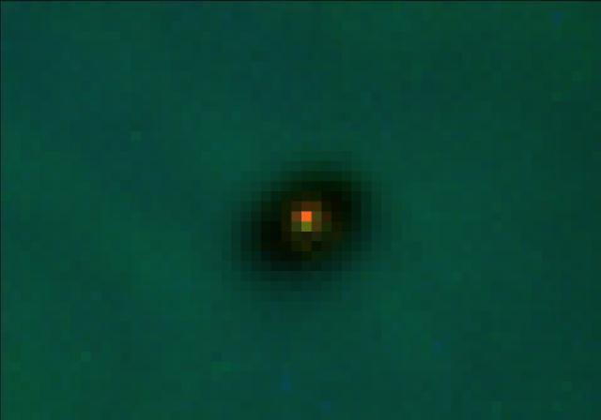
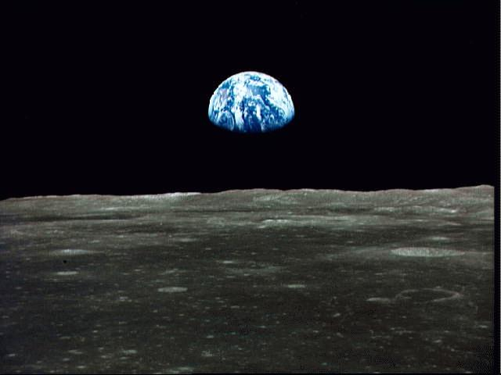
FDSCI 209 - How to Build a Habitable Planet
The Holy Scriptures teach that God made the world for us as a testing ground, so we could prove ourselves. In this course, we explore what is required to create and maintain a habitable world as discovered by modern science. Understanding the time and effort our Creator put into this world should motivate within us a deep sense of awe towards Him and His creations and deepen our sense of stewardship over this planet.

Slide 11
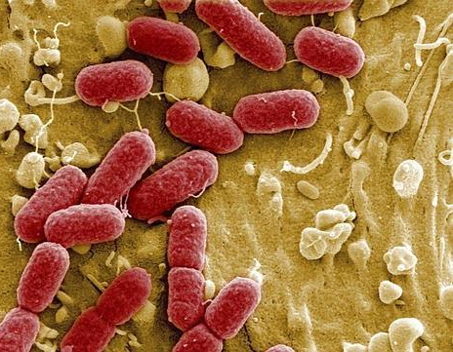
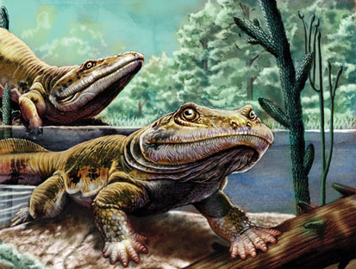
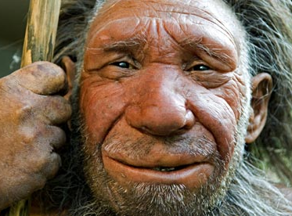
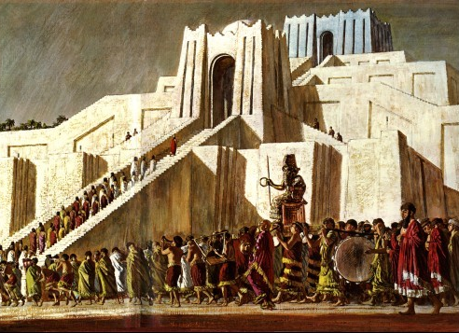
FDSCI 210 - Neanderthals and Other Successes
Ours is a planet of life. Evidence from fossils and molecules suggests that organisms have thrived on Earth for billions of years. However, less than one percent of the species that have ever existed on our planet are still alive today. What caused some species to succeed while others failed, and how did life on Earth begin in the first place? From the earliest bacteria to humans and their civilizations, this course addresses the origin, evolution, and extinction of life on earth based on evidence from chemistry, biology, geology, and related sciences.

Slide 12
Issues in Science Course Categorization
Course | Physical Science | Life Science | Social Science
FDSCI 200: Energy in 21st Century | X
FDSCI 201: Natural Disasters | X
FDSCI 202: Issues in Global Climate Change | X
FDSCI 203: Environmental Stewardship |  | X
FDSCI 204: The American Epidemic |  | X
FDSCI 205: DNA: Identity, Disease, Design |  | X
FDSCI 206: Light & Sound | X | X | X
FDSCI 208: Introduction to Robotics | X
FDSCI 209: How to Make a Habitable Planet | X
FDSCI 210: Neanderthals & Other Successes |  | X
Students must complete Issues in Science courses in two of the three different categories.

